Slide 1
Welcome to C programming for devices.
Week 2.

Slide 2
Convert following binary numbers to decimal and hexadecimal:
0010 1000
1011 0100
1010 1010
0101 0011

Slide 3
Convert to binary:
127
200
100
222

Slide 4
Convert to binary:
0xAA
0xEE
0xFE
0x43

Slide 5
Subjects for today:
Analog to digital converter
PWM (digital to analog)
Serial.print
Timer

Slide 6
Messure the light:

Slide 7
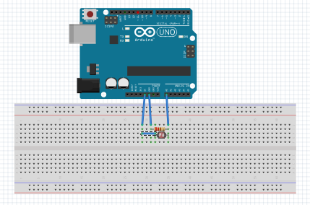

Slide 8
Setup function:
void setup() // analog reading
{
// initialize serial com at 9600 bps:
Serial.begin(9600);
// Analog input pin that reads the light
int lightPin = A0;
}

Slide 9
Loop function:
void loop()
{
int lightvalue;
int outputValue;
lightvalue = analogRead(lightPin);
delay(2);
outputValue = map(lightValue, 0, 1023, 0, 255);
Serial.println(outputValue);
}

Slide 10
Make a timer:

Slide 11
Setup function:
int second=0, minut=0; // Global variables
void setup() // timertest
{
Serial.begin(9600); // initialize serial
// communication
noInterrupts(); // disable all interrupts
TCCR1A = 0; //
TCCR1B = 0; //
timer1_startvalue = 3036; // preload timer 65536-
// 16MHz/256/1Hz
TCNT1 = timer1_startvalue;// preload timer
bitSet(TCCR1B, CS12); // 256 prescaler
bitSet(TIMSK1, TOIE1); // enable timer1 overflow
// interrupt
interrupts(); // enable all interrupts
}

Slide 12
Loop function:
void loop()
{
Serial.print(minut);
Serial.print(':');
if(sekund<10) Serial.print('0');
Serial.println(sekund);
}

Slide 13
Interrupt routine:
ISR(TIMER1_OVF_vect) // interrupt service
// routine
{
TCNT1 = timer1_startvalue; // reload timer1
sekund++; //
if (sekund > 59) //
{
sekund = 0;
minut++;
}
}

Slide 14
Assignment 4
Connect a LDR and a 1K resister in serial, connect the LED to 5 volt, and resistor til ground, the middelpoint between resistor and LED connects to an analog input pin.
With Serial.print check the values of the light in shadow and in light.
Turn on the LED pin 13 on when the LDR is in the shadow.

Slide 15
Assignment 5
Try with the resistor and the LDR to check the speed of the train, you have to turn on/off a timer, and then read the value with the Serial.print().

